Slide 1

Team 5(NEPUZB)
Pusparaj Bhujel 12194857
Sujan Bhujel 12194856
Abdulaziz 12194899
Izzatullokh Makhammodjonov 12194921

Slide 2

Dataset: COVID-19 Vaccination and Hesitancy Rates

Slide 3
Table of contents.
Potential Insights and Benefits to Society
Survey Design and Participants
The Survey Questions Included
Data Analysis Tools

Slide 4

As we grapple with the COVID-19 pandemic, vaccine hesitancy has emerged as a major concern. We are studying the factors that influence vaccine rates and hesitancy to determine strategies to increase vaccination. Understanding these dynamics is essential for preventing future outbreaks and promoting public health. We believe this information can be used to help the world recover from this global health crisis.

Slide 5
Potential Insights and Benefits to Society
Understanding
Understanding the factors that influence vaccine hesitancy, such as misinformation, distrust of authorities, and concerns about side effects.
Identifying
Identifying groups that are more likely to be vaccine-hesitant and developing targeted interventions to increase vaccine uptake in these communities.
Assessing
Assessing the impact of public health messaging and communication strategies on vaccine uptake.
Developing
Developing evidence-based recommendations for policymakers to promote vaccination and prevent outbreaks.
Providing
Providing guidance and recommendations to healthcare professionals on how to address vaccine hesitancy and promote vaccine uptake.
Promoting
Promoting public awareness of the importance of vaccines and the risks of not being vaccinated.
Contributing
Contributing to the larger conversation about vaccine policy and ethics.

Slide 6

Survey Design and Participants
We designed a survey to gather information on vaccine attitudes, beliefs, and behaviors. The survey was distributed to 30 participants, including individuals from different age groups, genders, ethnicities, and education levels.

Slide 7
The Survey Questions Included
Have you received a COVID-19 vaccine? If not, why not?
How confident are you in the safety and efficacy of the COVID-19 vaccine?
How much do you trust public health authorities and experts on vaccine recommendations?
Have you encountered any misinformation or conspiracy theories about COVID-19 vaccines? If so, where?
What factors would make you more likely to get vaccinated against COVID-19?
Have you experienced any side effects from the COVID-19 vaccine?

Slide 8
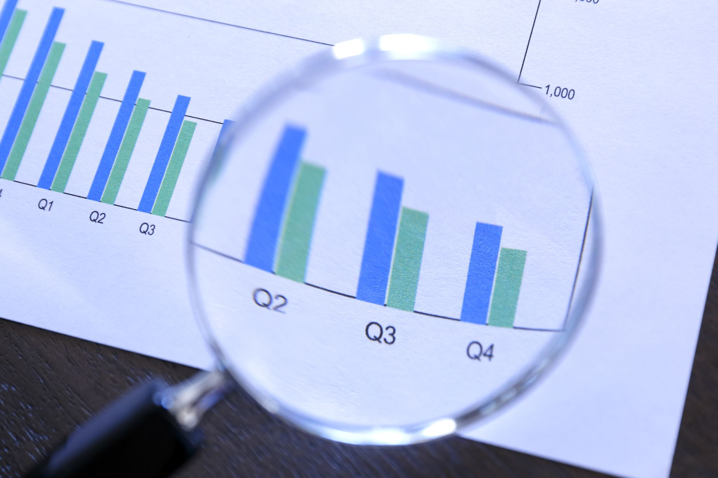
Data Analysis Tools
We use SPSS to analyze data in social science research. It offers tools for data manipulation, descriptive and inferential statistics, as well as data visualization.
We can use Microsoft Excel for data analysis, modeling, and visualization. It has tools for data manipulation, statistical analysis, and charting.
We are using Tableau to create interactive dashboards, charts, and maps. It's easy to integrate with different data sources and offers plenty of visualization options!

